Slide 1


ONLINE BANKING
SYSTEM

Slide 2

ABOUT US
welcome to our Backend Team
Group A
Members:
Abanoub Abo El Saad
Donia Ahmed Nasr Ahmed
Mahmoud Sobhy Mahmoud Abdullah
02

Slide 3
OUR ARCHITECTURE

Slide 4
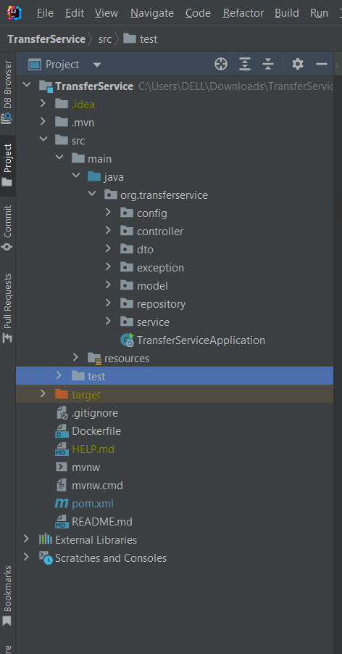
Overview of our architecture packages and what is containing :
config
controller
dto
enums
exception
model
repository
service
security
test

Slide 5
MODELS

Slide 6
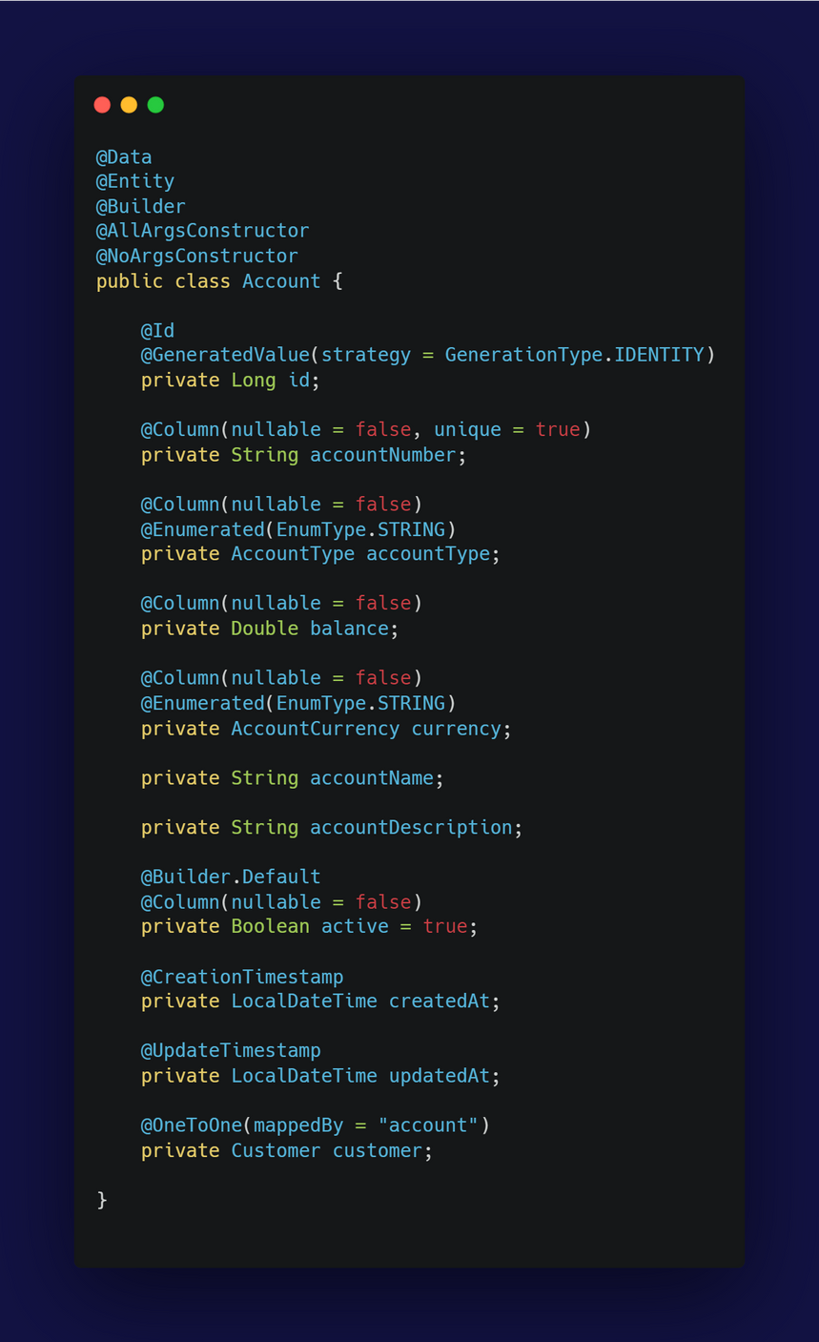
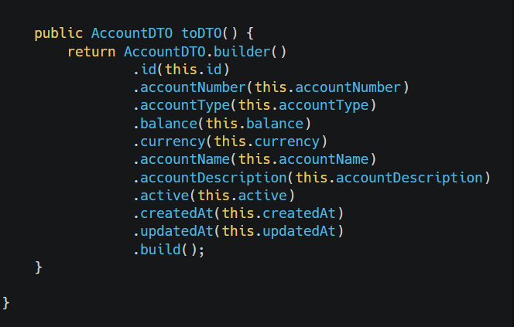
This class contains the attributes related to Account
toDTO(): Converts the Account entity to an AccountDTO for data transfer.
Used Builder Pattern for constructing Account and AccountDTO objects in a flexible and readable manner.
Single Responsibility Principle : The class is responsible solely for representing account data and its conversion to a DTO.
Open/Closed Principle : The class is designed to be extendable without modifying existing code.

Slide 7
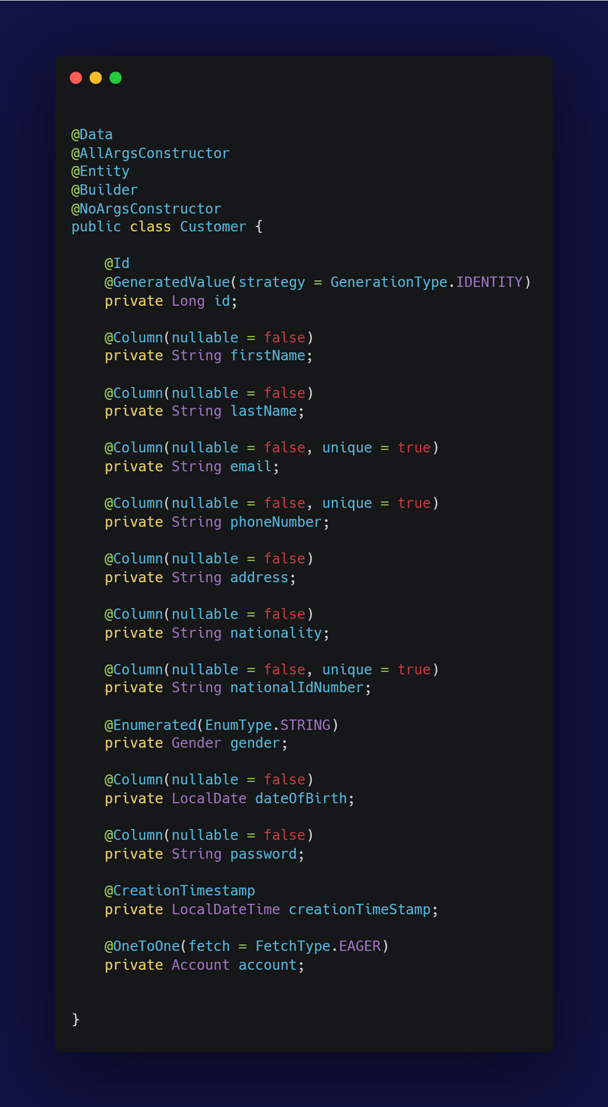
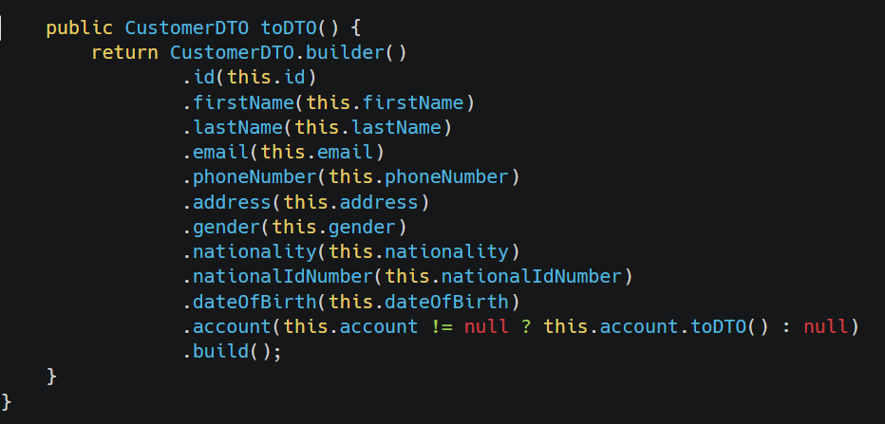
Same concept of Model Account

Slide 8
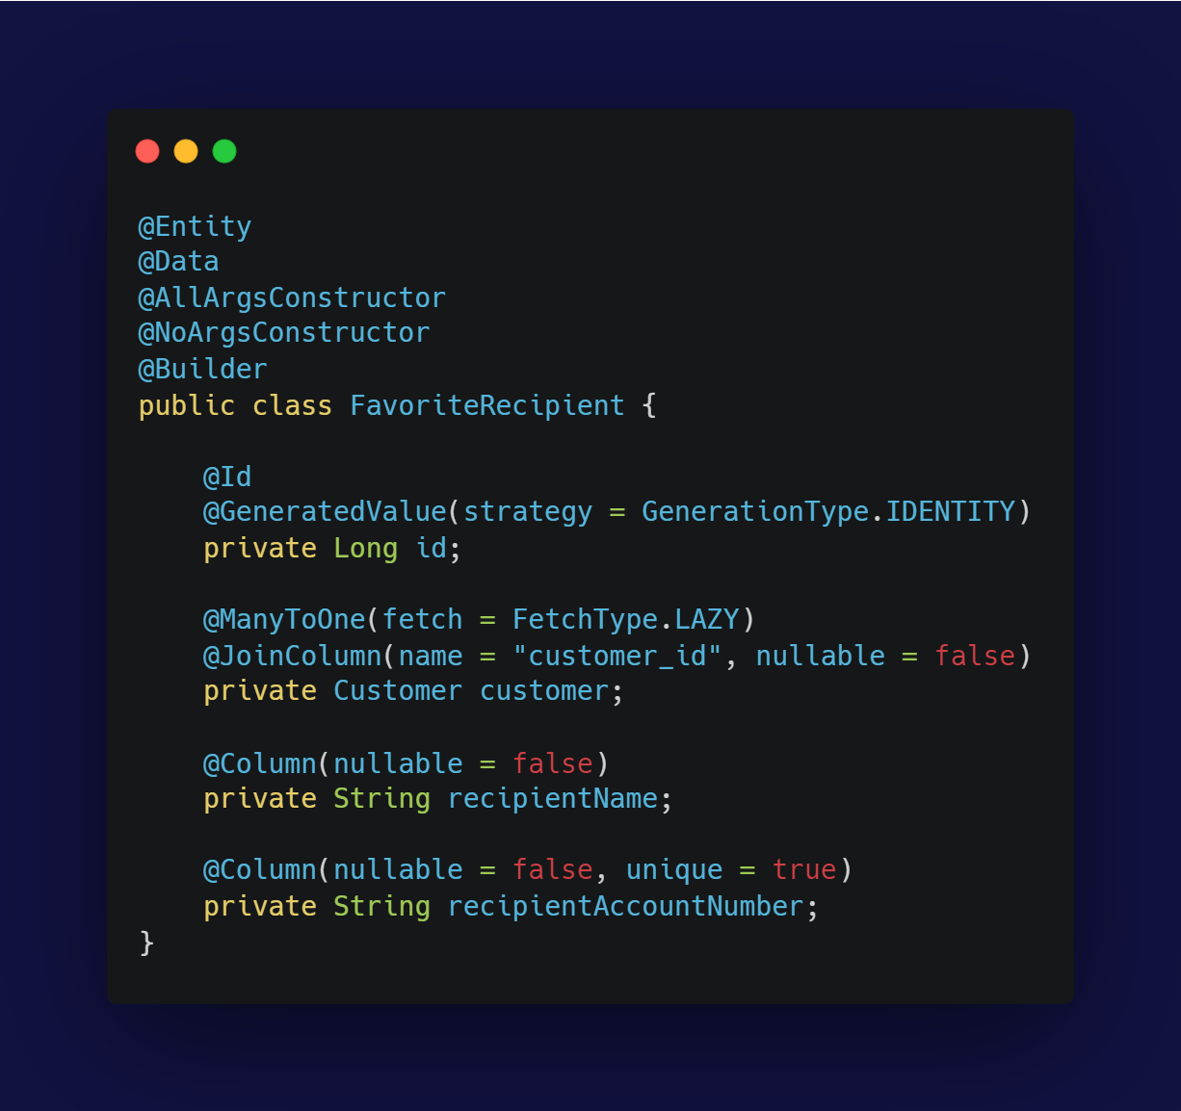
This Model takes the attributes of favoite recipient which will be needed in the functions of adding or removing recipient
Builder Pattern: Used for constructing FavoriteRecipient objects in a flexible and readable manner.
Dependency Injection: Promoted in the broader application context to manage dependencies and promote loose coupling

Slide 9
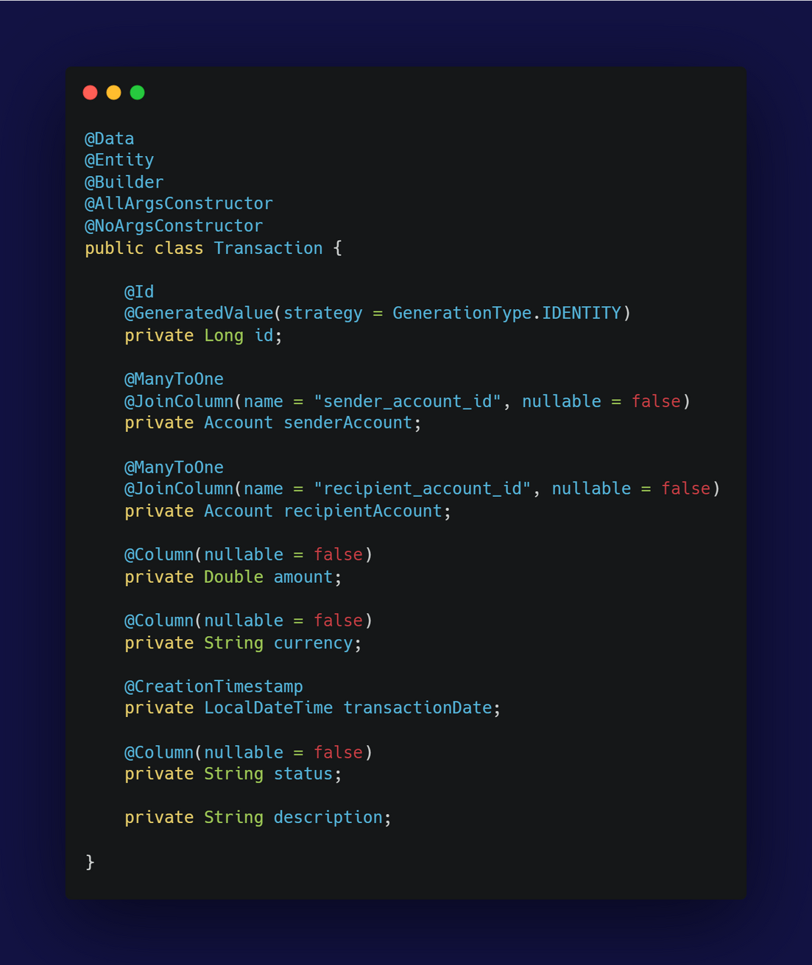
This class carries the attributes that is related to transactions
@GeneratedValue(strategy = GenerationType.IDENTITY): This JPA annotation is used to define the primary key generation strategy. GenerationType.IDENTITY indicates that the primary key is generated by the database (typically auto-incremented).
@ManyToOne: This JPA annotation defines a many-to-one relationship between entities. In this case, it means that many transactions can be associated with a single account.
@JoinColumn(name = "sender_account_id", nullable = false): This JPA annotation specifies the foreign key column for the senderAccount relationship. It also indicates that this column cannot be null.

Slide 10
REPOSITORY
which will be the link between the Model and the services

Slide 11
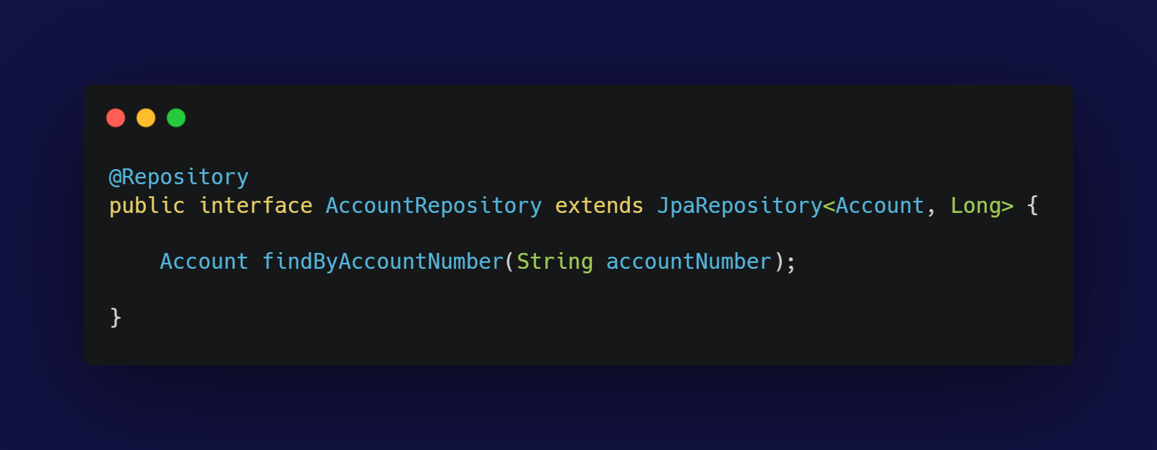
The AccountRepository interface extends JpaRepository, providing standard CRUD operations and querying capabilities for the Account entity. Here's a brief overview of the components:
@Repository: This Spring annotation indicates that the interface is a repository and helps with exception translation into Spring's DataAccessException hierarchy. It also enables component scanning to detect and register the repository as a Spring bean.
JpaRepository<Account, Long>: This interface extends JpaRepository, which provides several methods for interacting with the Account entity:
Account is the type of the entity.
Long is the type of the entity's primary key

Slide 12
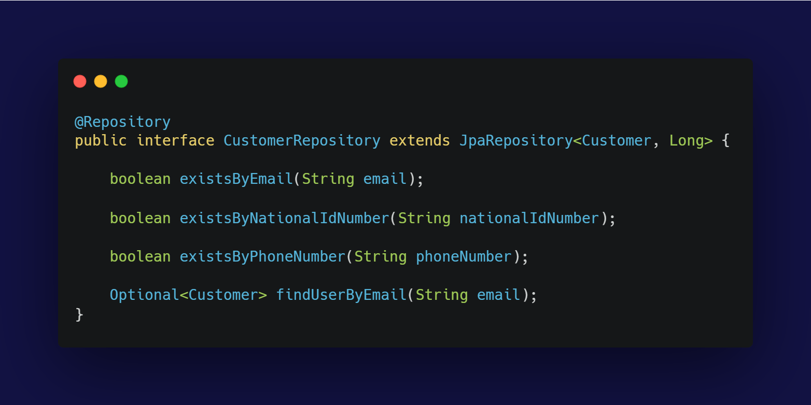
CustomerRepository offers methods for checking the existence of customers based on different attributes and for retrieving a customer by their email address, leveraging Spring Data JPA's automatic query generation.

Slide 13
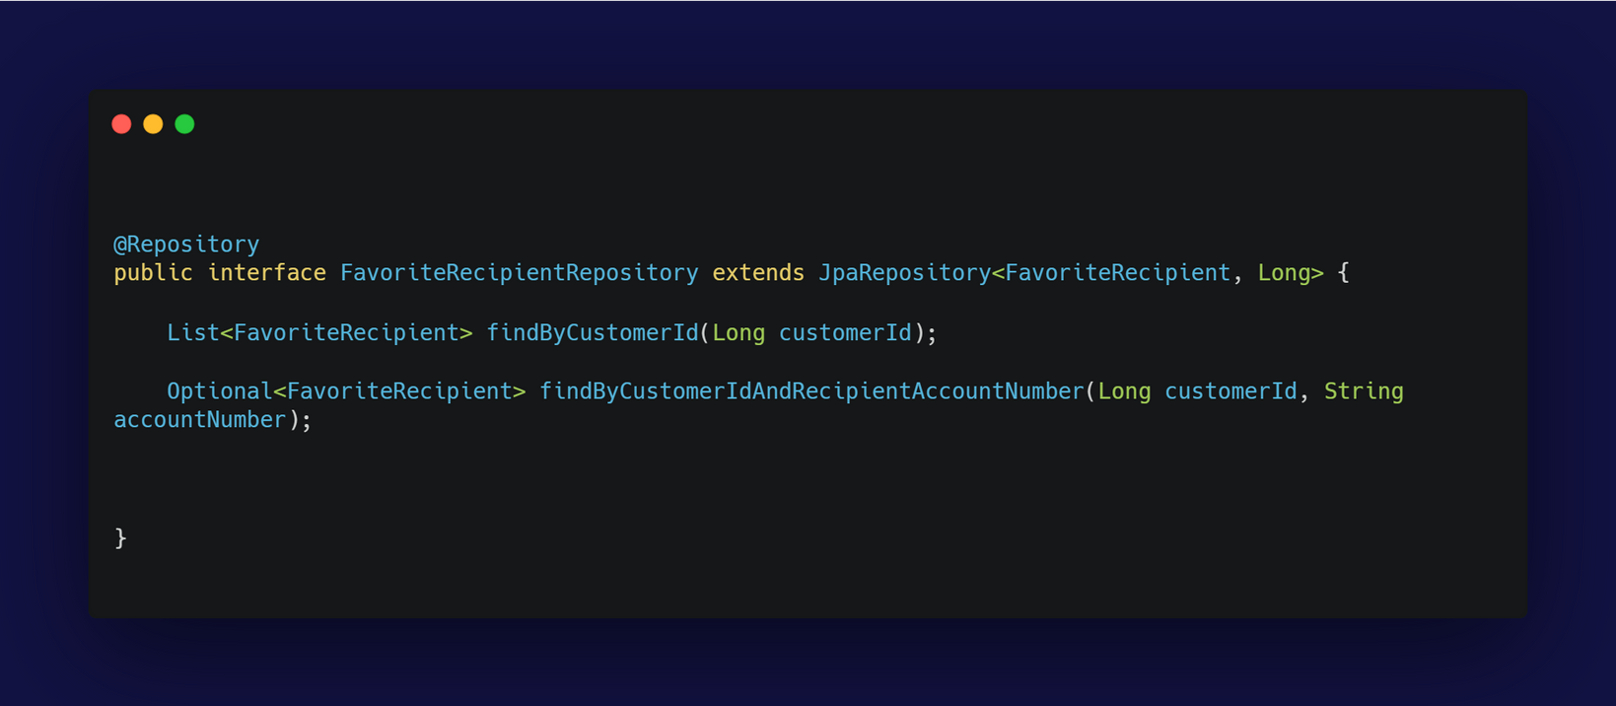
JpaRepository<FavoriteRecipient, Long>: Inherits basic CRUD operations and JPA functionalities for FavoriteRecipient entities:
FavoriteRecipient is the type of the entity.
Long is the type of the entity's primary key.
findByCustomerIdAndRecipientAccountNumber(Long customerId, String accountNumber): Retrieves an Optional<FavoriteRecipient> for a given customer ID and recipient account number and it is useful also for checking if a particular recipient is a favorite for a specific customer.
findByCustomerId(Long customerId): Retrieves a list of FavoriteRecipient entities associated with a specific customer ID. This method helps in fetching all favorite recipients for a given customer.

Slide 14
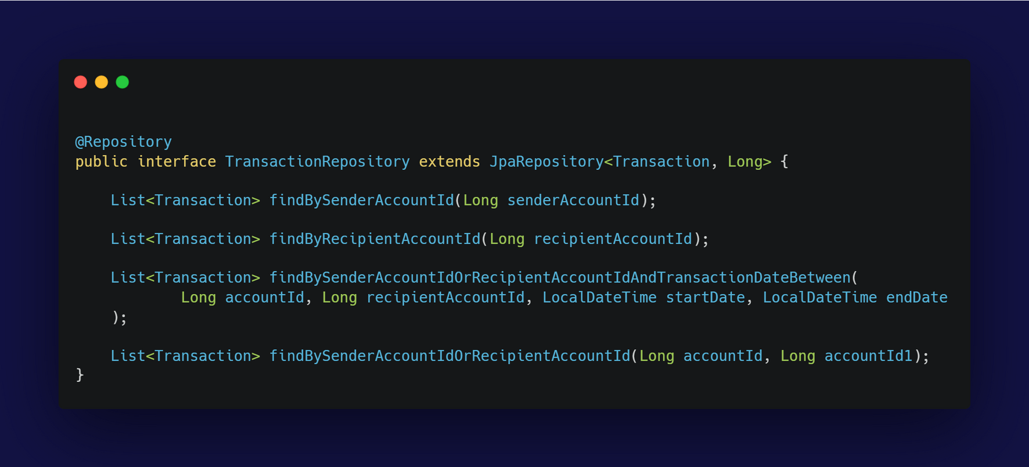
Single Responsibility Principle :
The TransactionRepository has a single responsibility to handle data access for Transaction entities So it is focused on database operations related to transactions.
OCP :
The repository interface is open for extension (e.g., by adding new methods or custom queries) but closed for modification. You can add more methods without changing existing code.
Query Method Derivation: automatically generates the implementation based on method names.
DAO Pattern:
The repository acts as a DAO, providing methods to perform CRUD operations and queries on the Transaction entity.

Slide 15
EXCEPTIONS

Slide 16
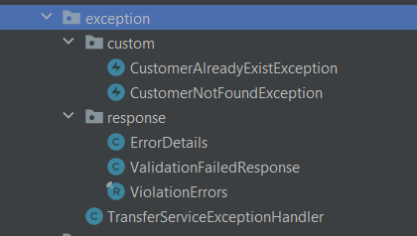
We make a base exception handler that contains the common exception handling in the projet
Separating the others into two packages in custom and response

Slide 17
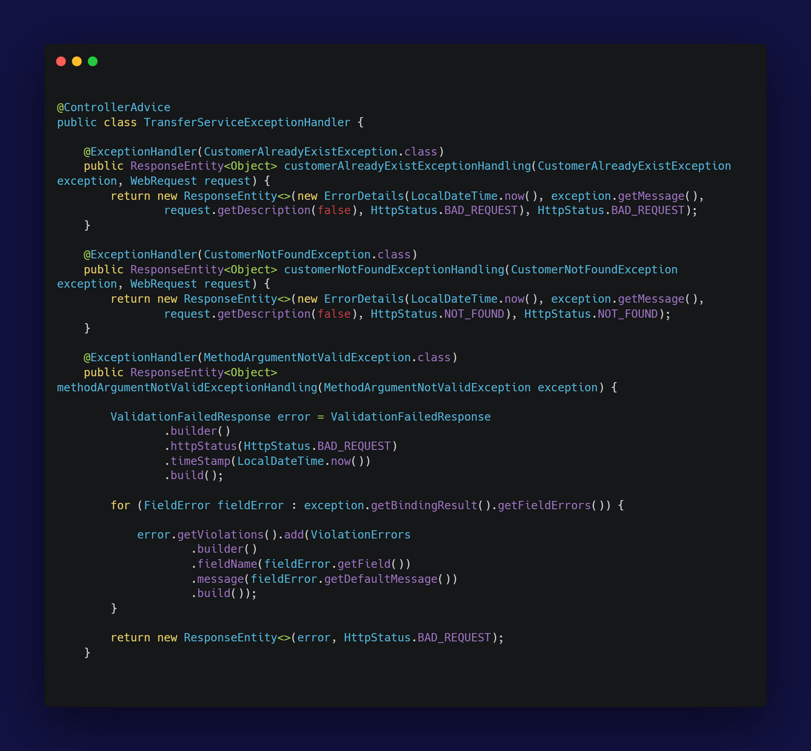
@ControllerAdvice: This annotation allows the class to handle exceptions across the whole application in a centralized manner and It ensures that exception handling logic is separated from the controllers.

Slide 18
Single Responsibility Principle :
Adherence: The TransferServiceExceptionHandler adheres to SRP by focusing solely on handling exceptions and generating appropriate error responses. Each method has a single responsibility related to handling a specific type of exception.
Open/Closed Principle :
The class is open for extension (e.g., adding new exception handlers) but closed for modification. You can extend its functionality by adding new methods without changing existing ones.
Liskov Substitution Principle (LSP):
The methods in the class handle various exceptions, and the class can be extended or modified without affecting the correct handling of exceptions. It adheres to LSP as it does not rely on any subclass-specific behavior.
Interface Segregation Principle (ISP):
This principle is not directly applicable since ControllerAdvice is not an interface that clients implement. However, the class provides a focused set of methods specifically for handling exceptions, adhering to the concept of not forcing unnecessary methods on users.
Dependency Inversion Principle (DIP):
The class depends on abstractions (e.g., Exception, WebRequest) and not on concrete implementations. It uses Spring's mechanisms to handle exceptions, promoting dependency on abstractions.

Slide 19
Exception Handling Pattern:
The class implements the Exception Handling pattern by providing a centralized way to handle different types of exceptions and generate appropriate HTTP responses
Builder Pattern:
The ValidationFailedResponse and ViolationErrors objects use the Builder pattern (via Lombok’s @Builder annotation) to create complex objects in a readable and maintainable way.

Slide 20
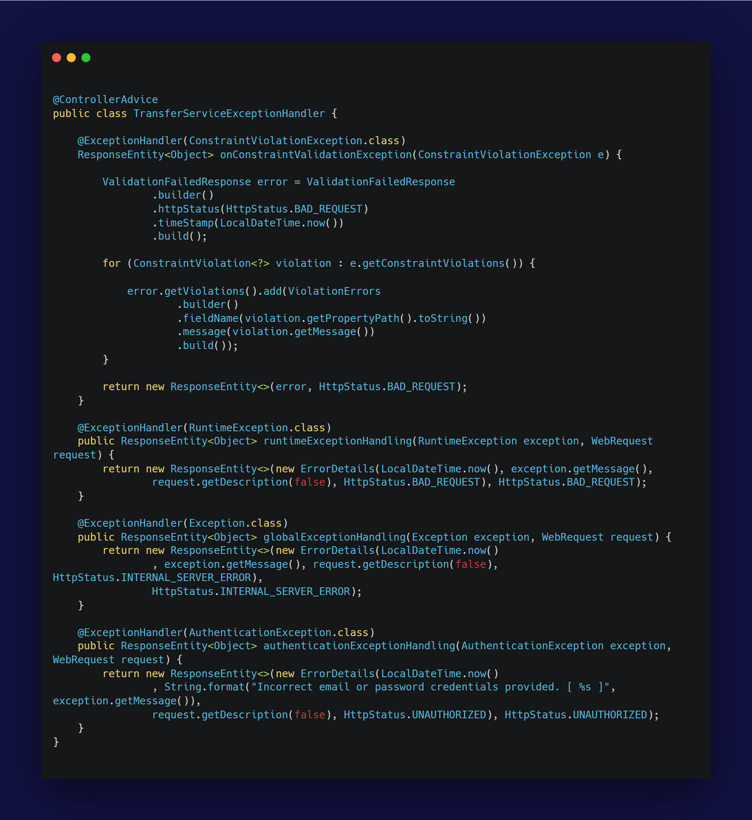
onConstraintValidationException: returns a 400 Bad Request response with a list of constraint violations.
runtimeExceptionHandling: returns a 400 Bad Request response with details about the error.
globalExceptionHandling: Handles any other exceptions that are not specifically caught by the previous handlers and returns a 500 Internal Server Error response with details about the error.
authenticationExceptionHandling: returns a 401 Unauthorized response with a specific error message.
same design pattern and SOLID principels

Slide 21
DTO

Slide 22
ENUMS

Slide 23
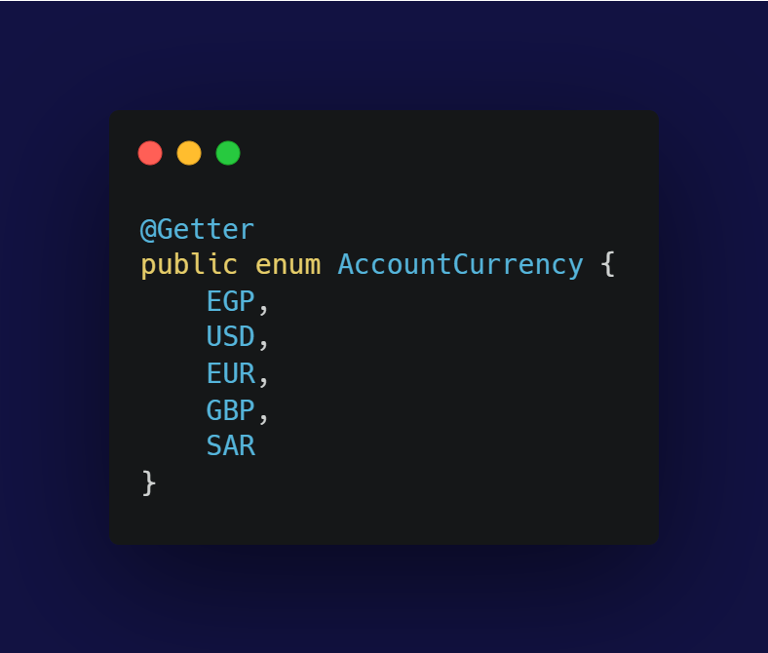
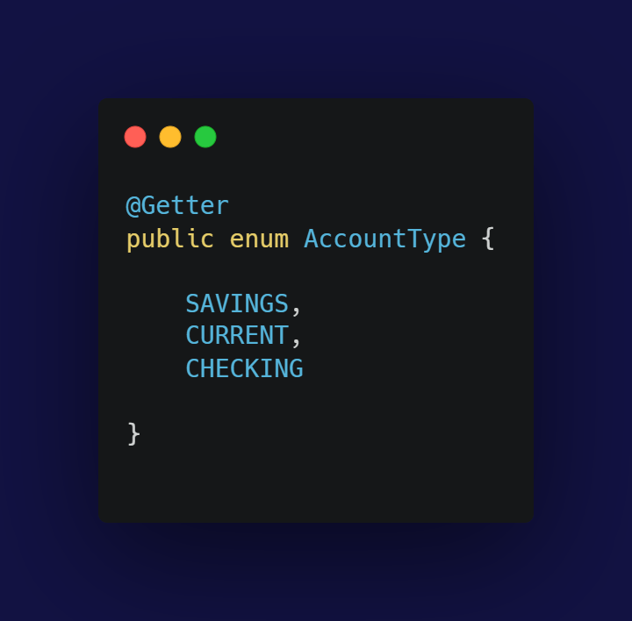
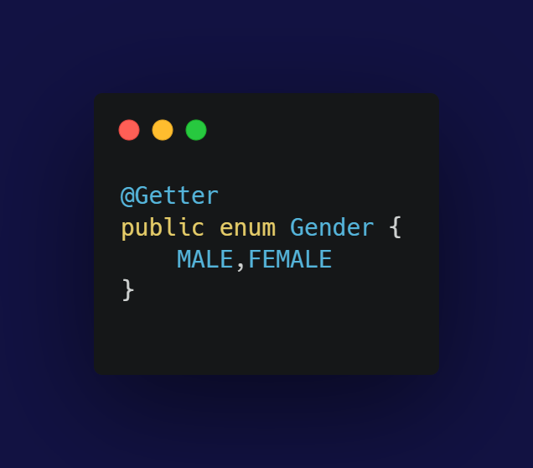
@Getter: This Lombok annotation generates a getter method for each field in the class. Since enum constants are typically accessed through their names, this annotation might be used if you want to provide additional methods or fields in the future.
So Purpose of enum is
Type Safety:
Enums provide a type-safe way to represent a fixed set of constants.
Namespace Control:
Enums help in organizing related constants into a single namespace.

Slide 24
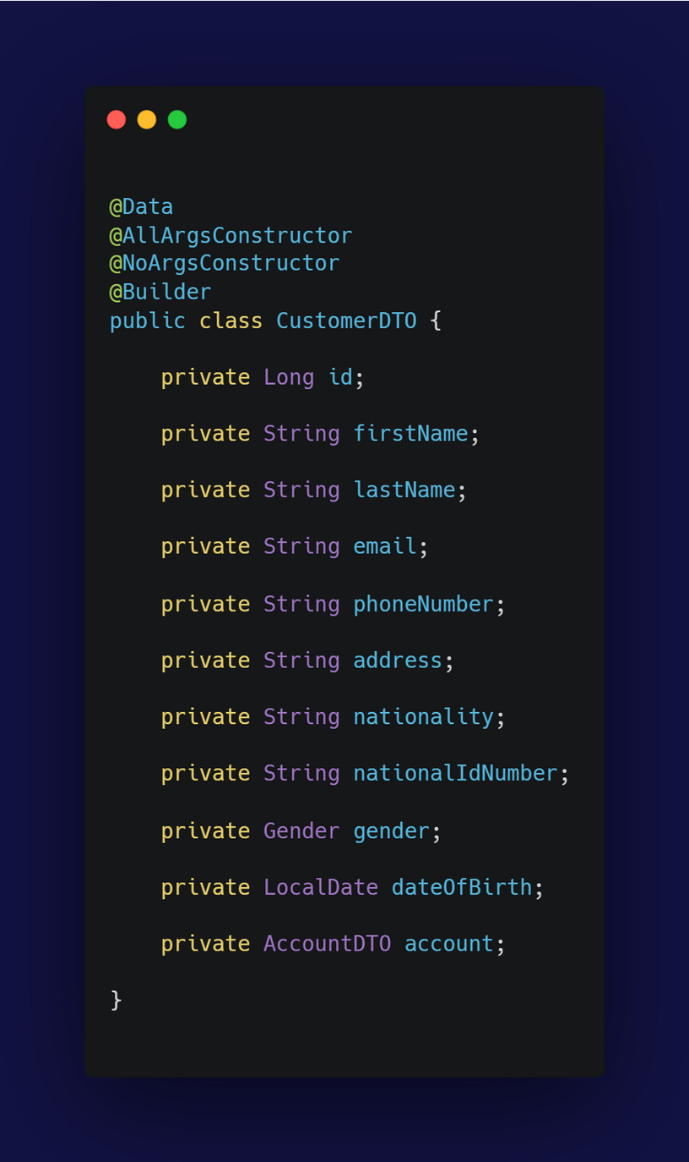
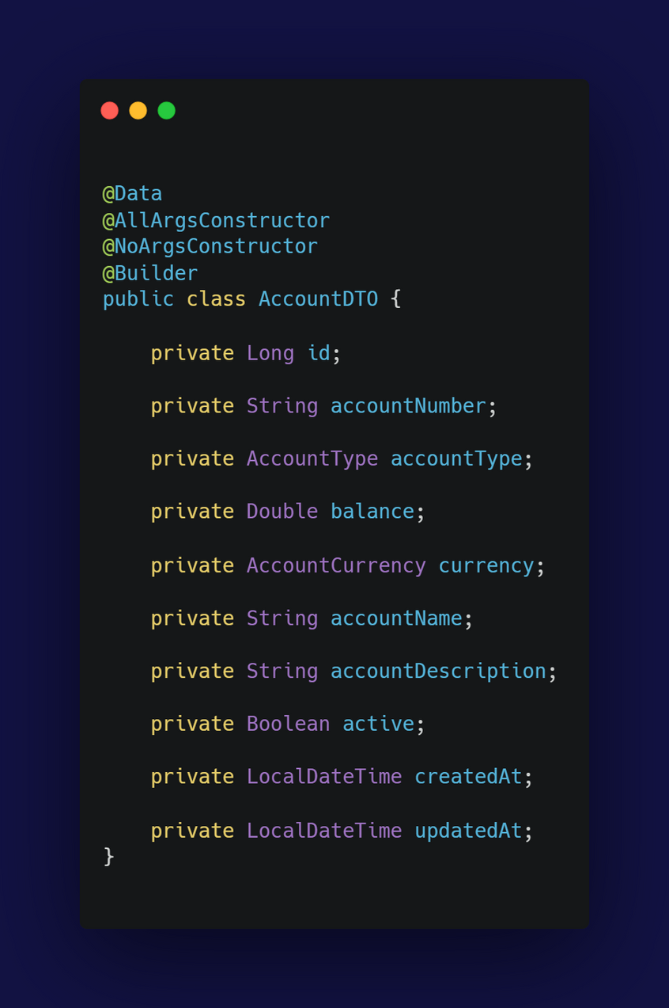
These DTO classes are used to transfer data between different layers of the application, such as from the service layer to the controller layer, or from the controller layer to the view layer. DTOs help in encapsulating the data in a structured format, making it easier to manage and maintain.

Slide 25
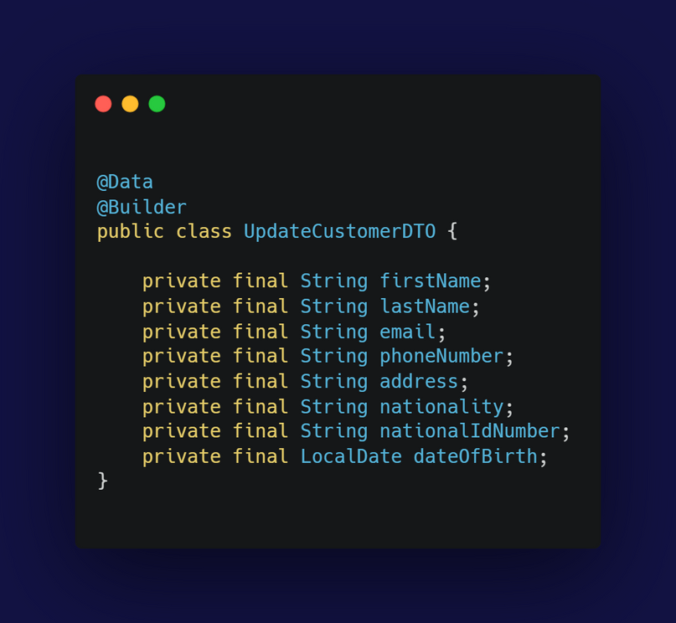
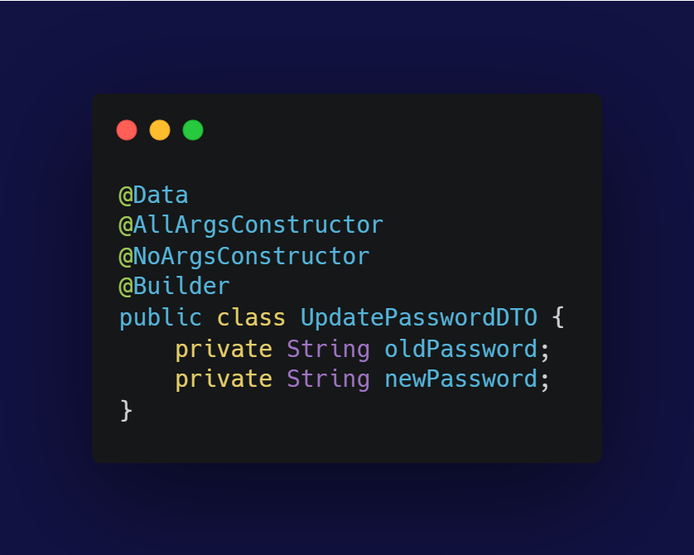
same as the previous DTO and all upcoming DTOS

Slide 26
SERVICE

Slide 27
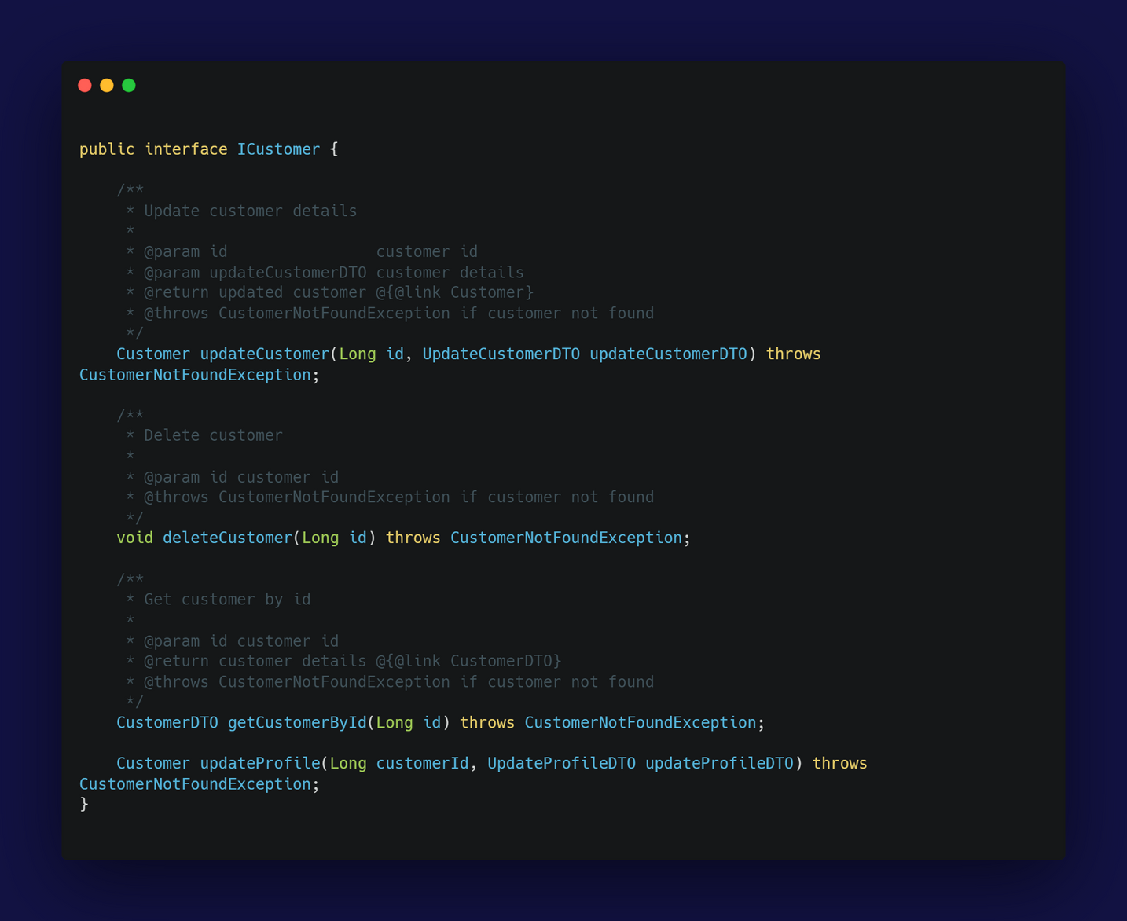
The ICustomer interface defines the contract for customer-related operations in the service layer of the application. It provides methods for updating, deleting, and retrieving customer details, as well as updating a customer's profile
Single Responsibility Principle (SRP): Each method in the ICustomer interface serves a single purpose related to customer management.
Open/Closed Principle : The interface can be extended without modifying existing code.
Liskov Substitution Principle : Any class implementing ICustomer can be used interchangeably with the interface.
Interface Segregation Principle : The interface is focused on customer management, avoiding unrelated methods.
Dependency Inversion Principle : The interface provides an abstraction for customer operations, promoting loose coupling.

Slide 28
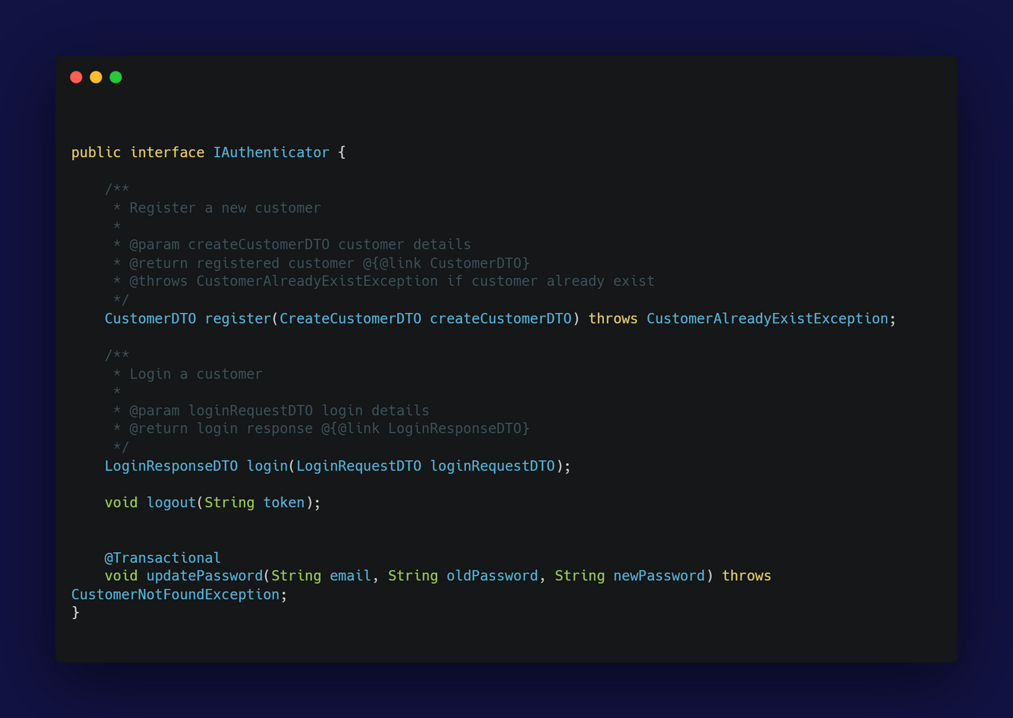
The same logic as ICustomer but this for Authenticator

Slide 29
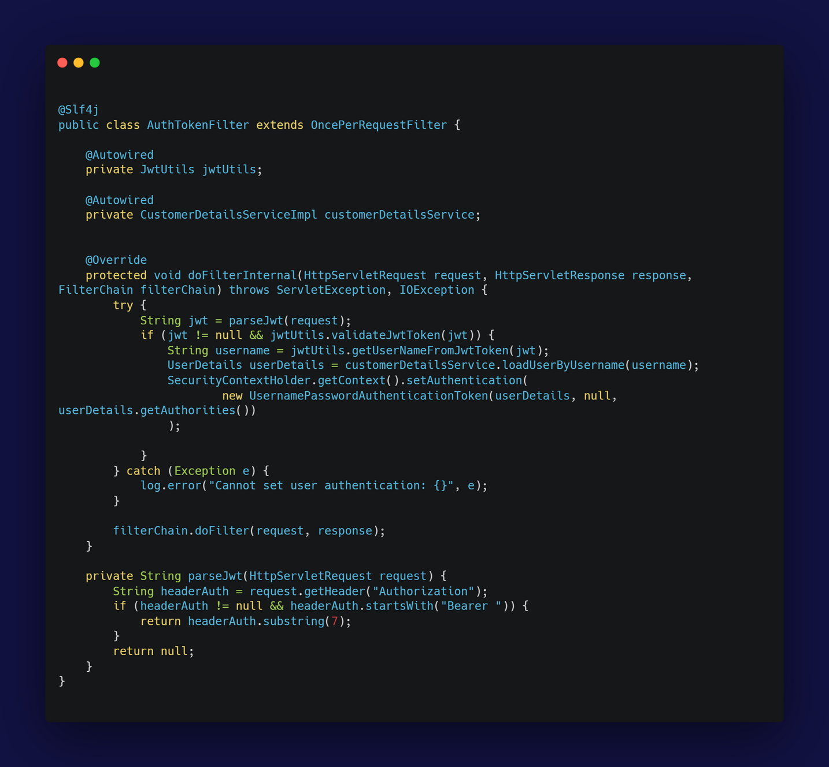
The AuthTokenFilter class is a custom filter that extends OncePerRequestFilter from the Spring Security framework. This filter is responsible for parsing and validating JSON Web Tokens (JWT) in HTTP requests to authenticate users
@Slf4j here is from Lombok and provides a logger instance (named log) for logging purposes.
Calls parseJwt(request) to extract the JWT from the request header then Checks if the extracted JWT is valid using jwtUtils.validateJwtToken(jwt) so If the JWT is valid, extracts the username from the token using jwtUtils.getUserNameFromJwtToken(jwt) ,then loads user details from the database using customerDetailsService.loadUserByUsername(username). Creates a UsernamePasswordAuthenticationToken with the user details and sets it in the SecurityContextHolder for the current request and finally Logs any exceptions that occur during the process.

Slide 30
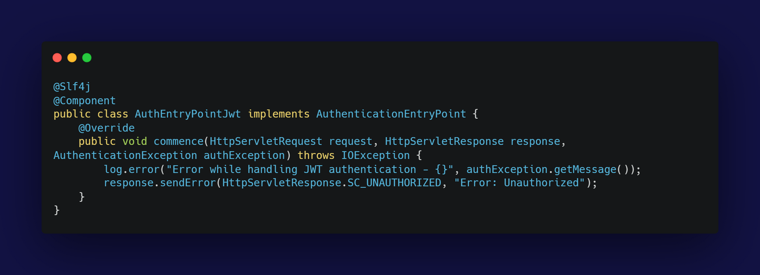
The AuthEntryPointJwt class implements the AuthenticationEntryPoint interface from Spring Security. It is responsible for handling unauthorized access attempts by providing a custom response
Commence method invokes whenever an exception is thrown due to an unauthenticated user trying to access a protected resource.

Slide 31
CONTROLLER

Slide 32
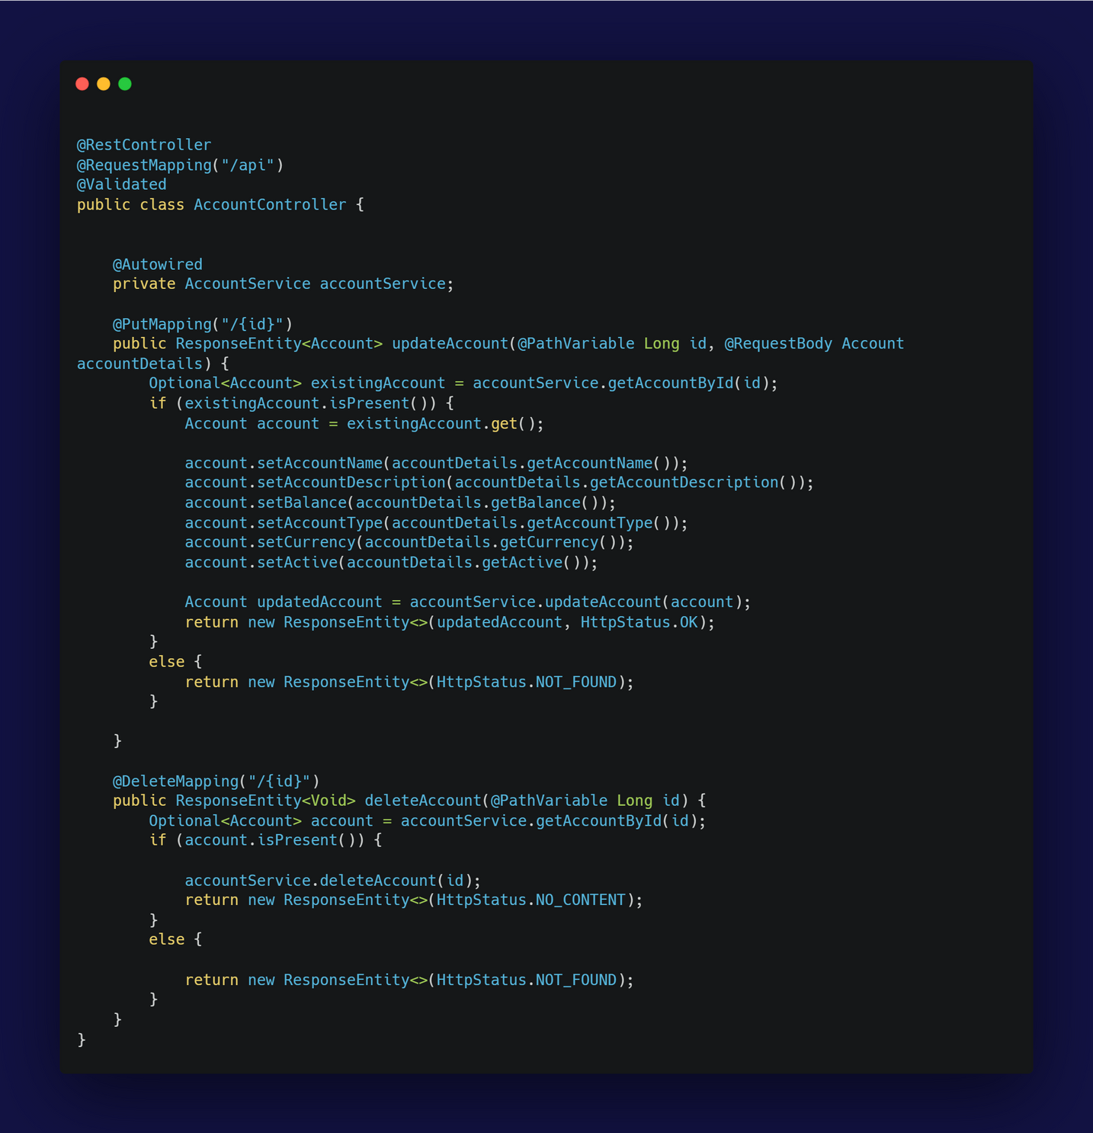
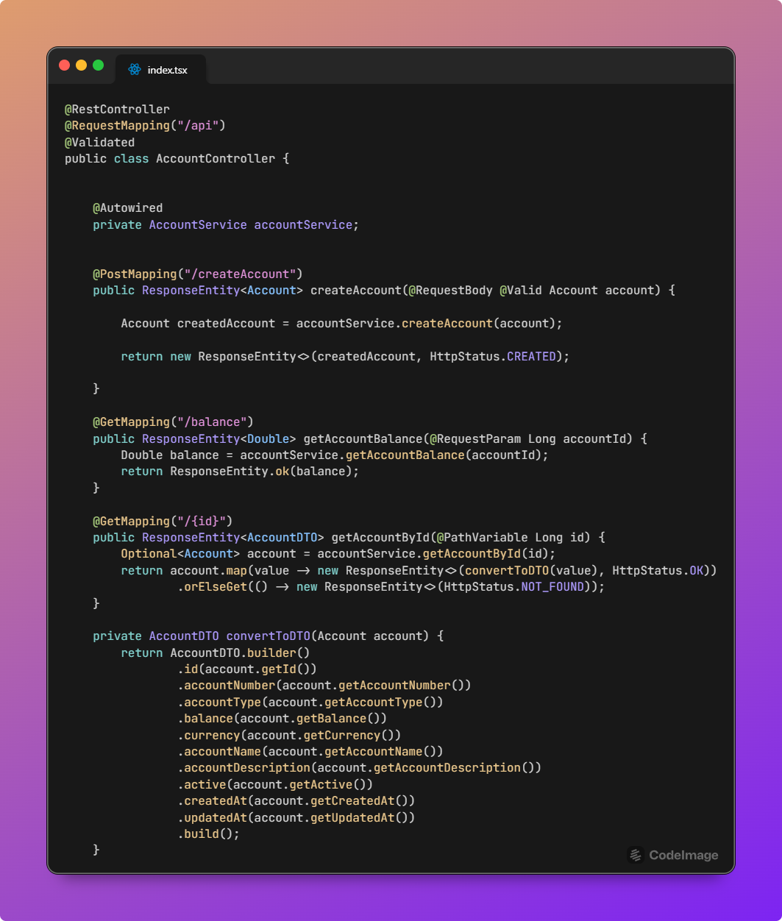

Slide 33
The AccountController class is a REST controller in the Spring framework that handles HTTP requests related to Account operations.
@Validated is used to ensure that the validation constraints on method parameters are required
@Autowired private AccountService accountService, This field is injected with an instance of AccountService which contains the business logic for handling Account operations.
Open/Closed Principle :
The AccountController class can be extended with new functionalities (like adding new endpoints) without modifying existing code. The use of annotations and separate service classes allows for easy extension.
Single Responsibility Principle:
The controller is only responsible for receiving HTTP requests, invoking the desired service methods, and returning responses

Slide 34
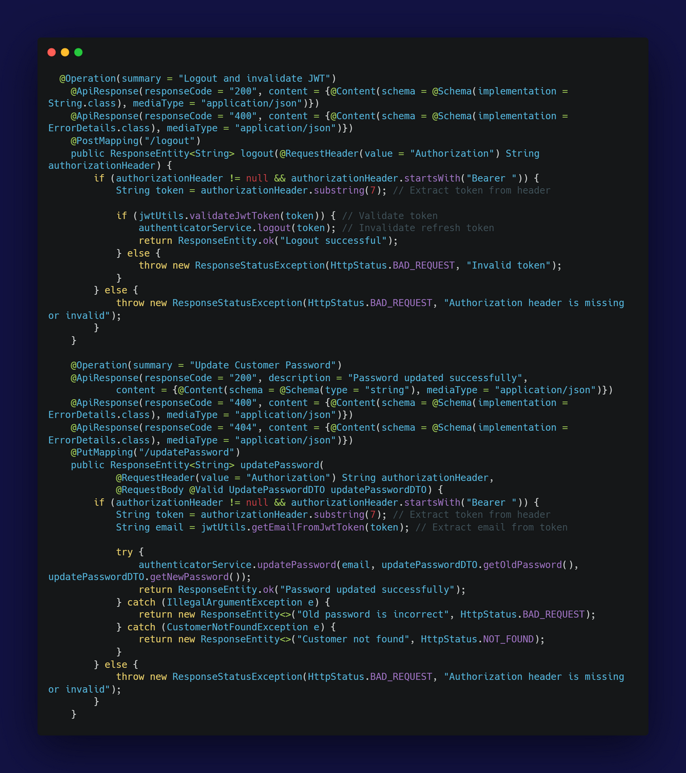
The AccountController class implements critical security features by providing endpoints for user logout , password update , login and register
The logout functionality in the AccountController class is designed to invalidate the JWT token and effectively log the user out , it receives the Logout Request then validate JWT Token , The extracted token is validated using the jwtUtils.validateJwtToken(token) method , If the token is not valid, a ResponseStatusException with HTTP status 400 and message "Invalid token" is thrown , If the token is valid, the authenticatorService.logout(token) method is called to invalidate the token , then Sending Response if If the token was successfully invalidated and

Slide 35
The updatePassword method in the AccountController class is responsible for updating a customer's password. so it is secured with JWT authentication, ensuring that only authorized users can change their password. The method performs validation checks and interacts with the authenticatorService to handle the password update process.
So the API Responses as in the code :
200 OK: Password updated successfully. Response body contains a success message.
400 Bad Request: Returned if the old password is incorrect or if the request is malformed. Includes details in the ErrorDetails schema.
404 Not Found: Returned if the customer is not found. Includes details in the ErrorDetails schema.
Authorization Header extracts from the request header, it must start with Bearer and includes the JWT token.
UpdatePasswordDTO Contains the old and new passwords, validated with @Valid.
Check if the Authorization header is present and valid ,extract the JWT token by removing the Bearer prefix , we use the jwtUtils to decode the JWT token and extract the email address of the user , it Catches IllegalArgumentException if the old password is incorrect and returns a 400 Bad Request response and
Catches CustomerNotFoundException if the customer is not found and returns a 404 Not Found response.

Slide 36
UNIT TESTING

Slide 37
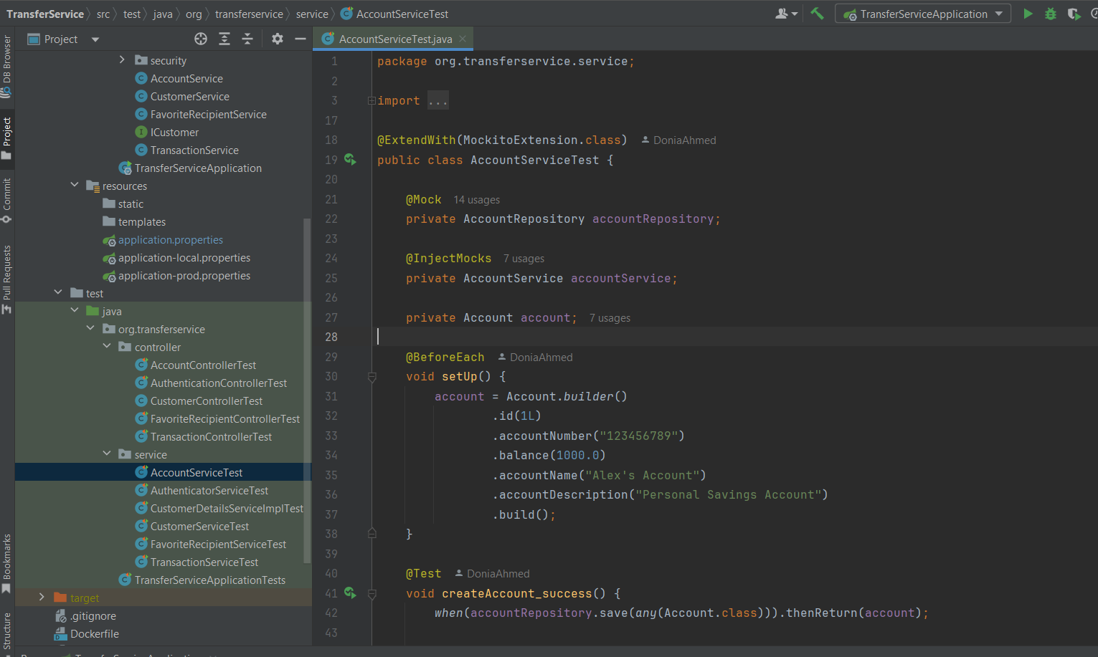


Testing for all the services and the endpoints apis
starting with AccountServiceTest
03

Slide 38
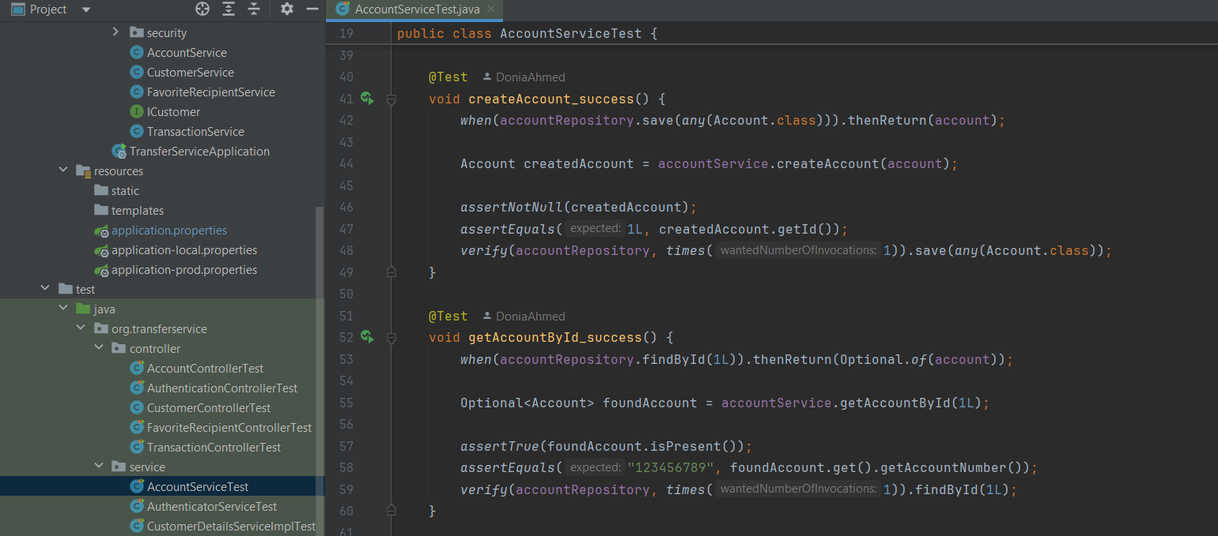

Testing all the functions
04

Slide 39
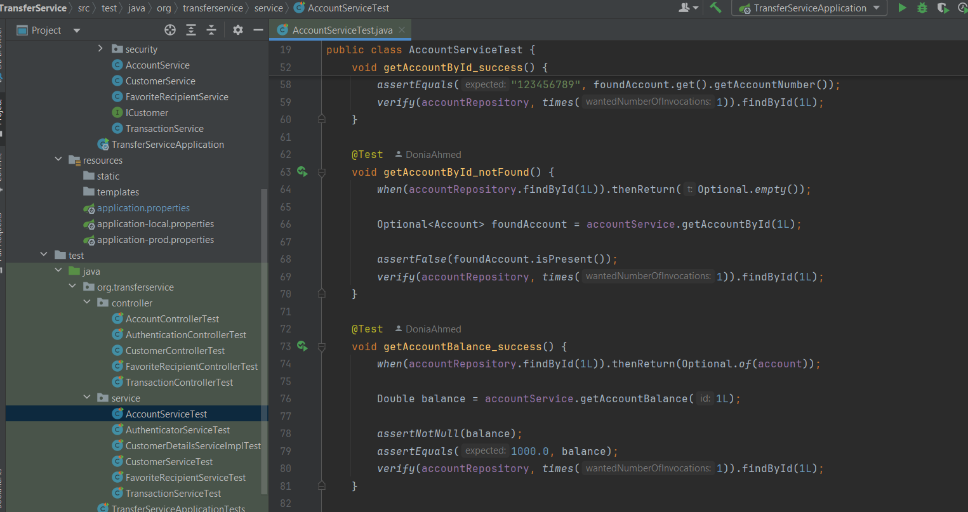
Testing the other functions
05

Slide 40
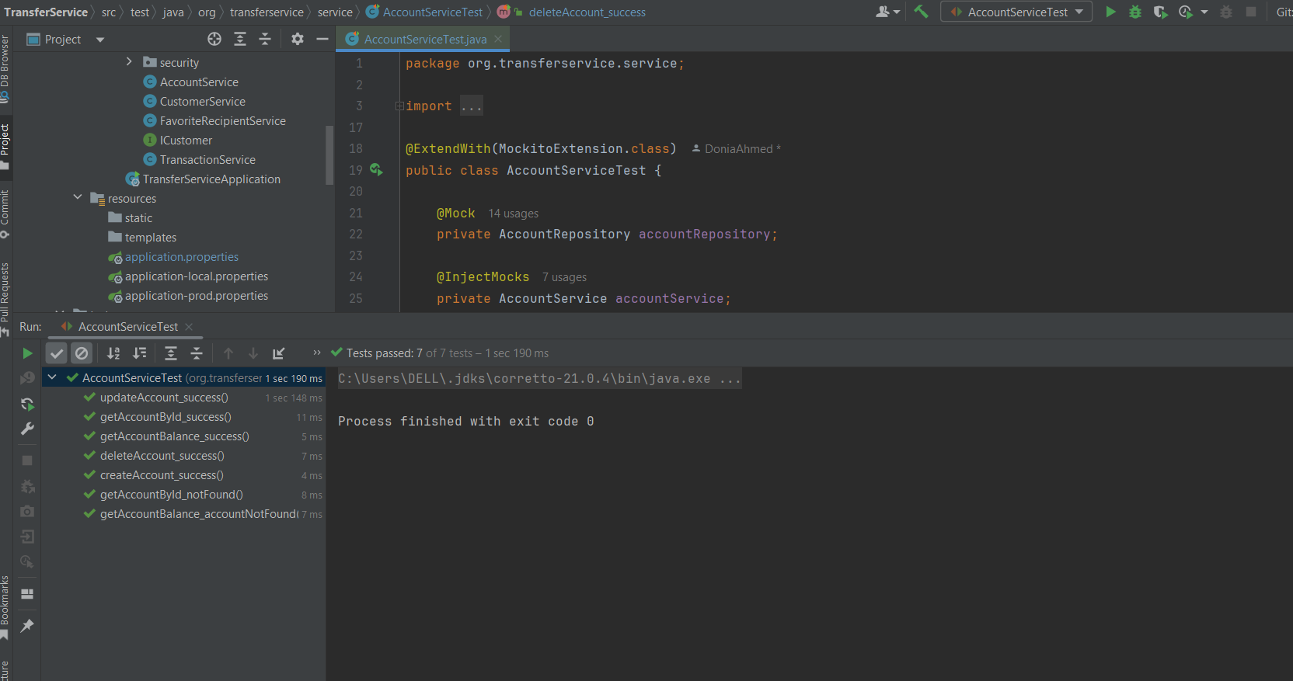
As we see all the test cases has passed successfully
06

Slide 41
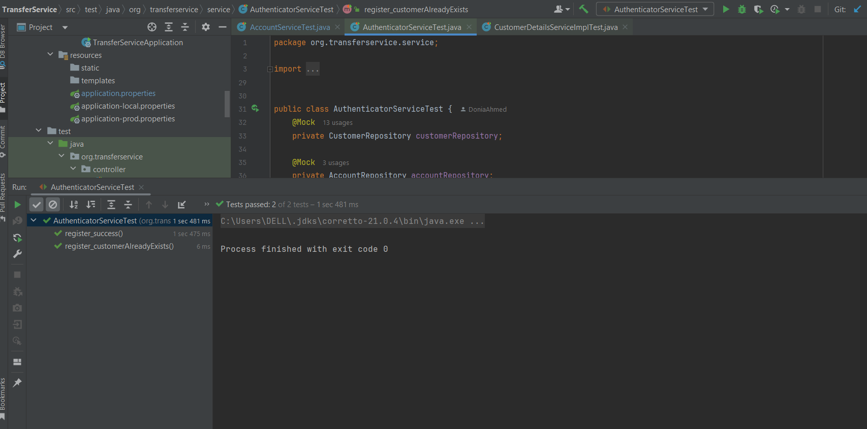
The test casses of the AuthenticatorService has passed successfully as we see
07

Slide 42
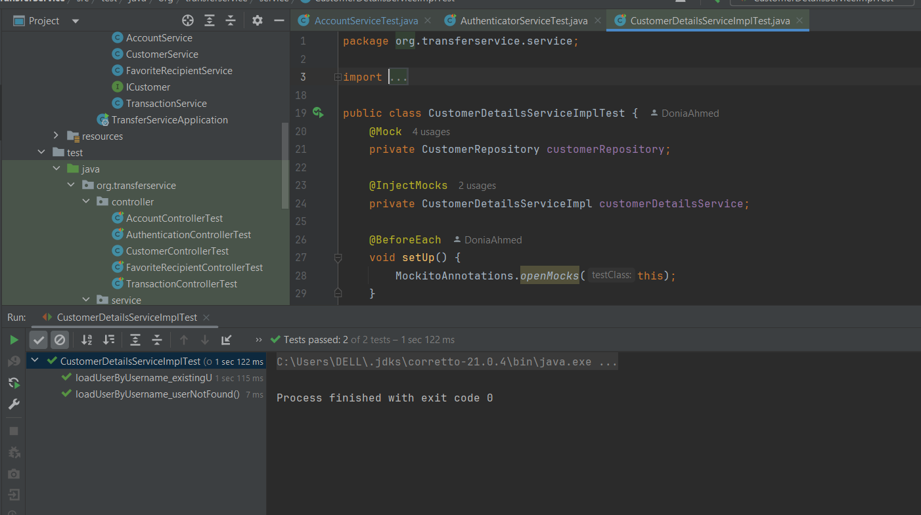
The test casses of the CustomerDetailsServiceImpl has passed successfully as we see
08

Slide 43
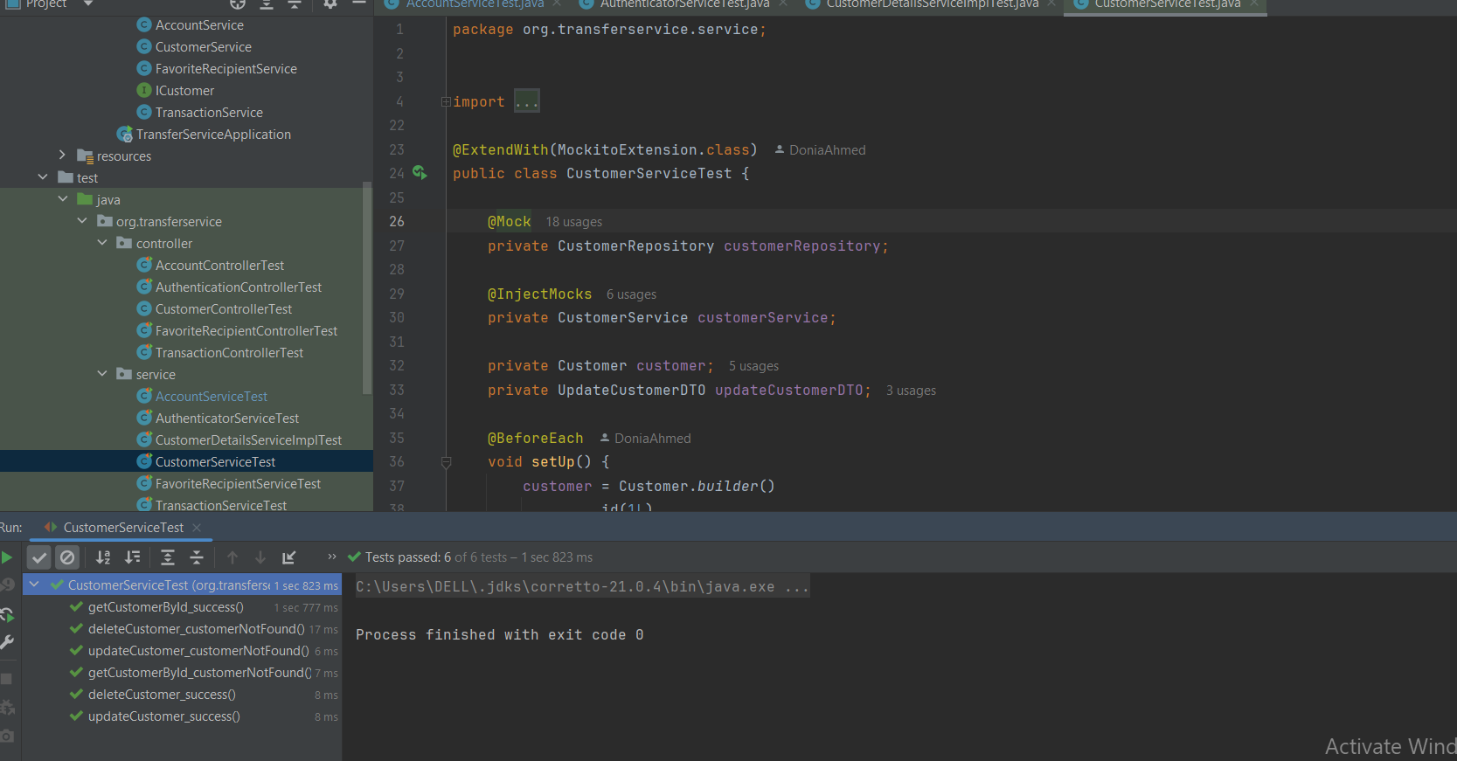
The test casses of the CustomerDetailsService has passed successfully here
09

Slide 44
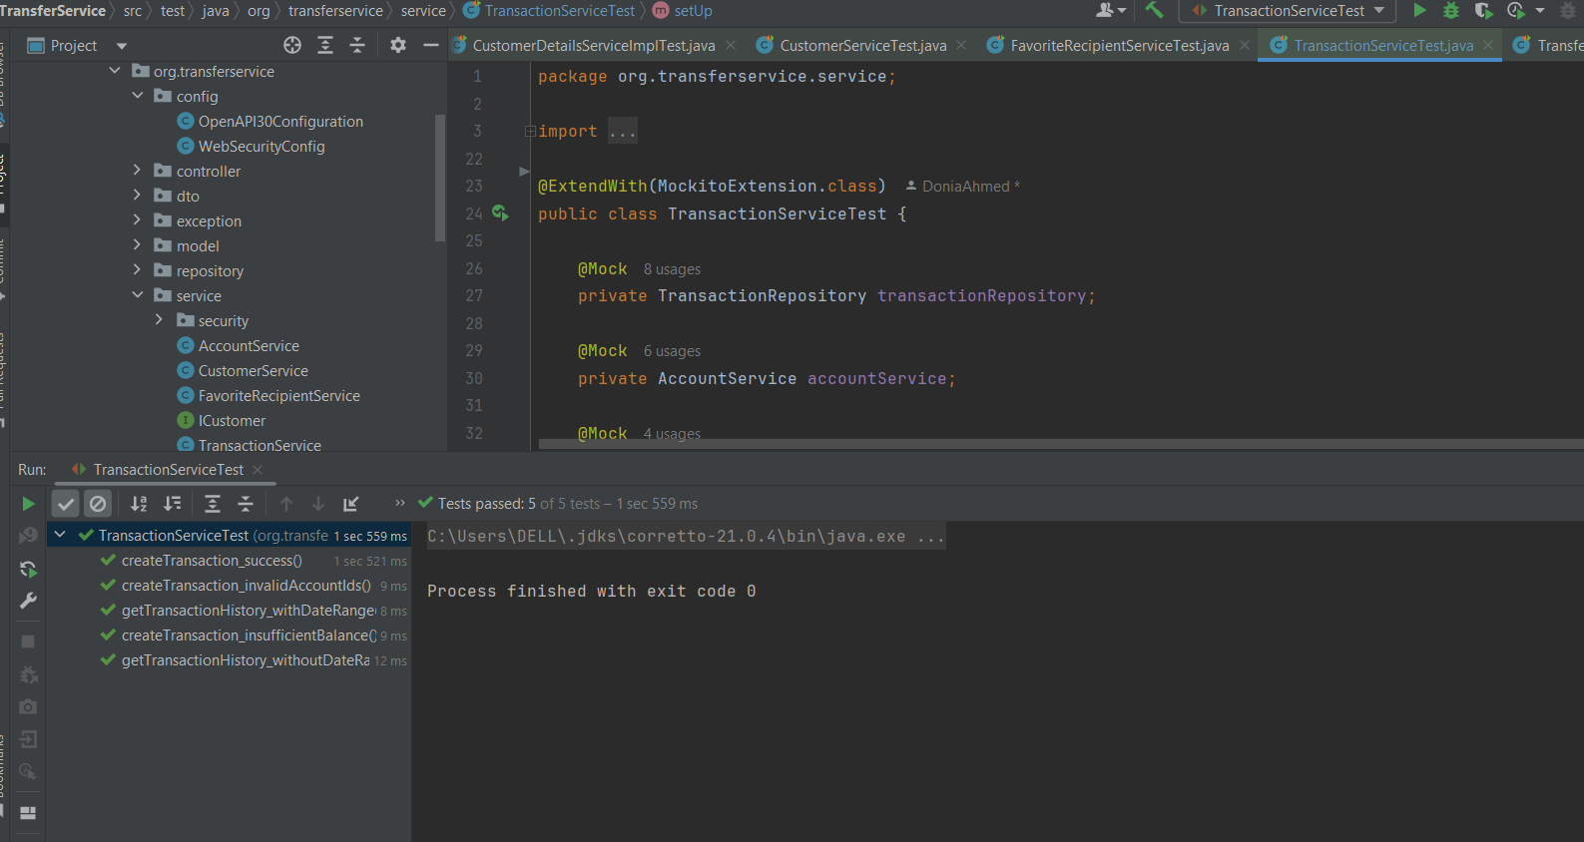
The test casses of the TransactionServiceTest has passed successfully as we see
10

Slide 45
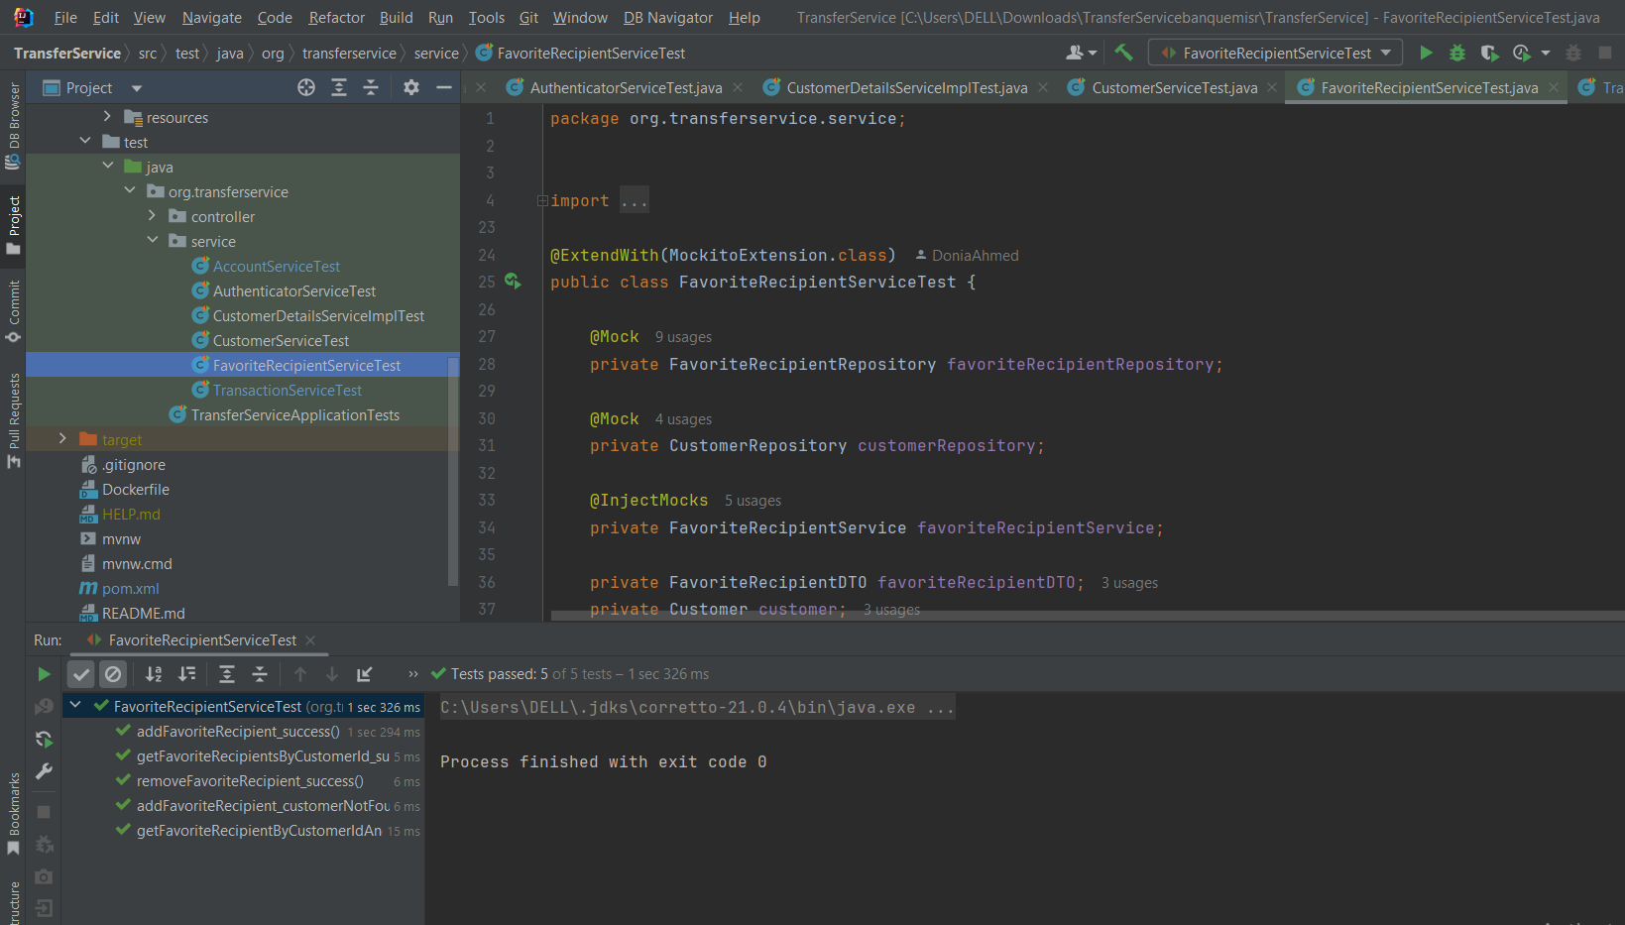
The test casses of the FavoriteRecipientService has passed successfully as well

Slide 46
DEPLOYMENT

Slide 47
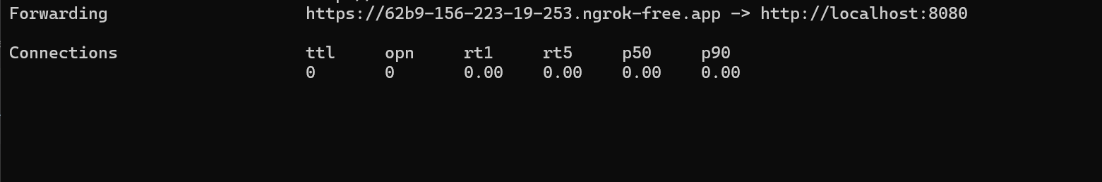
WE USED NAGROK FOR DEPLOYMENT
wich enable us to use https by using certificate and by that we do the security encryption
between the network transfer

Slide 48
SESSION MANAGMENT

Slide 49
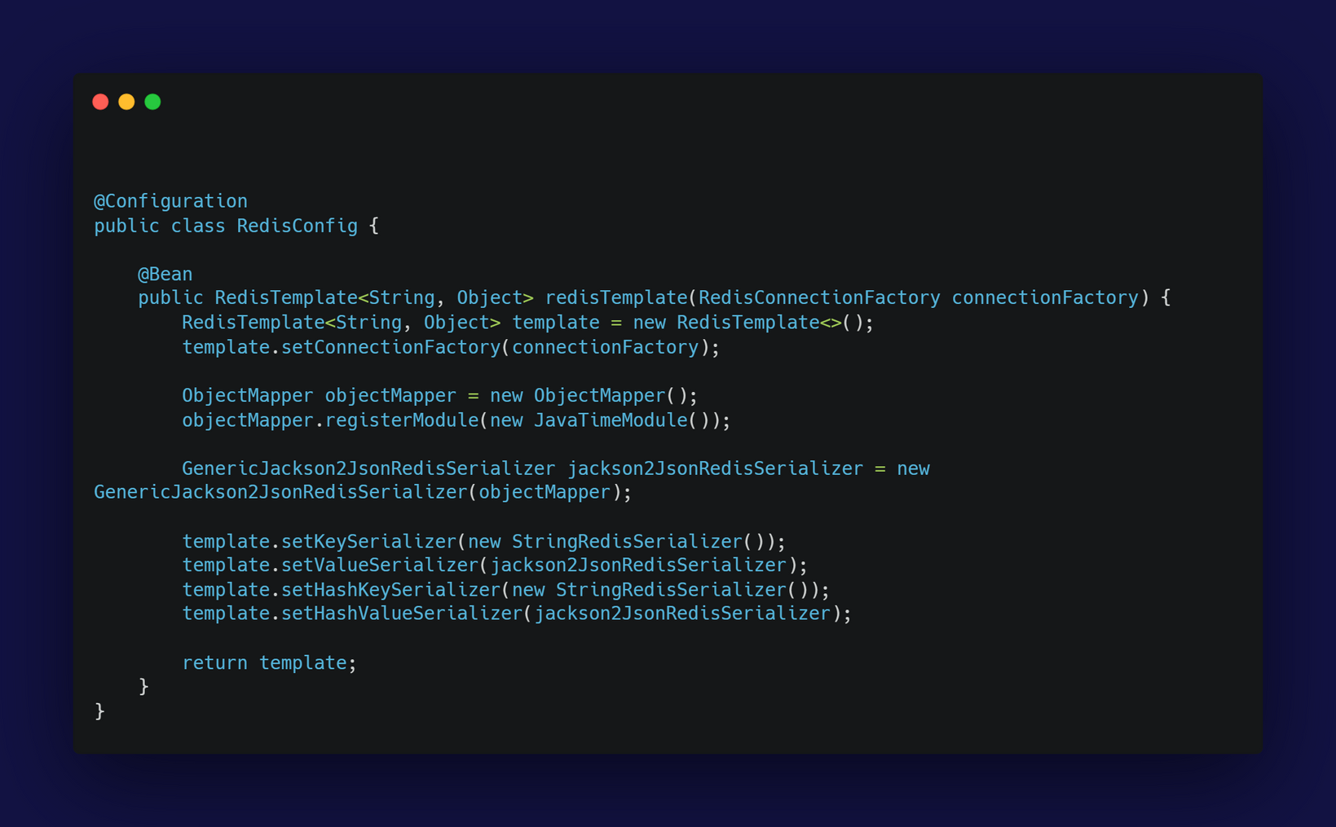
The configuration of redis: This setup ensures that connected to the Redis Server data and stored in Redis is properly serialized and deserialized, particularly handling complex objects and date-time types with the help of Jackson's ObjectMapper and JavaTimeModule.
In summary, this class configures a RedisTemplate to connect to a Redis server and handle JSON serialization of objects

Slide 50
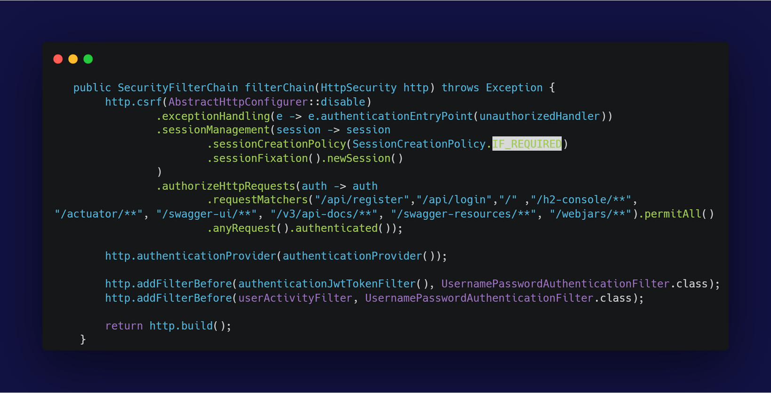
configurations security settings for a Spring Boot application before build the http request, As all Requests pass from here, handling authentication exceptions, managing session policies, setting authorization rules, using custom authentication providers, and adding (custom filters for JWT processing and user activity filter tracking). This setup is typical for applications that use JWTs for authentication and require custom session handling that managed on cache memory on Redis and saved the activity on the Database

Slide 51
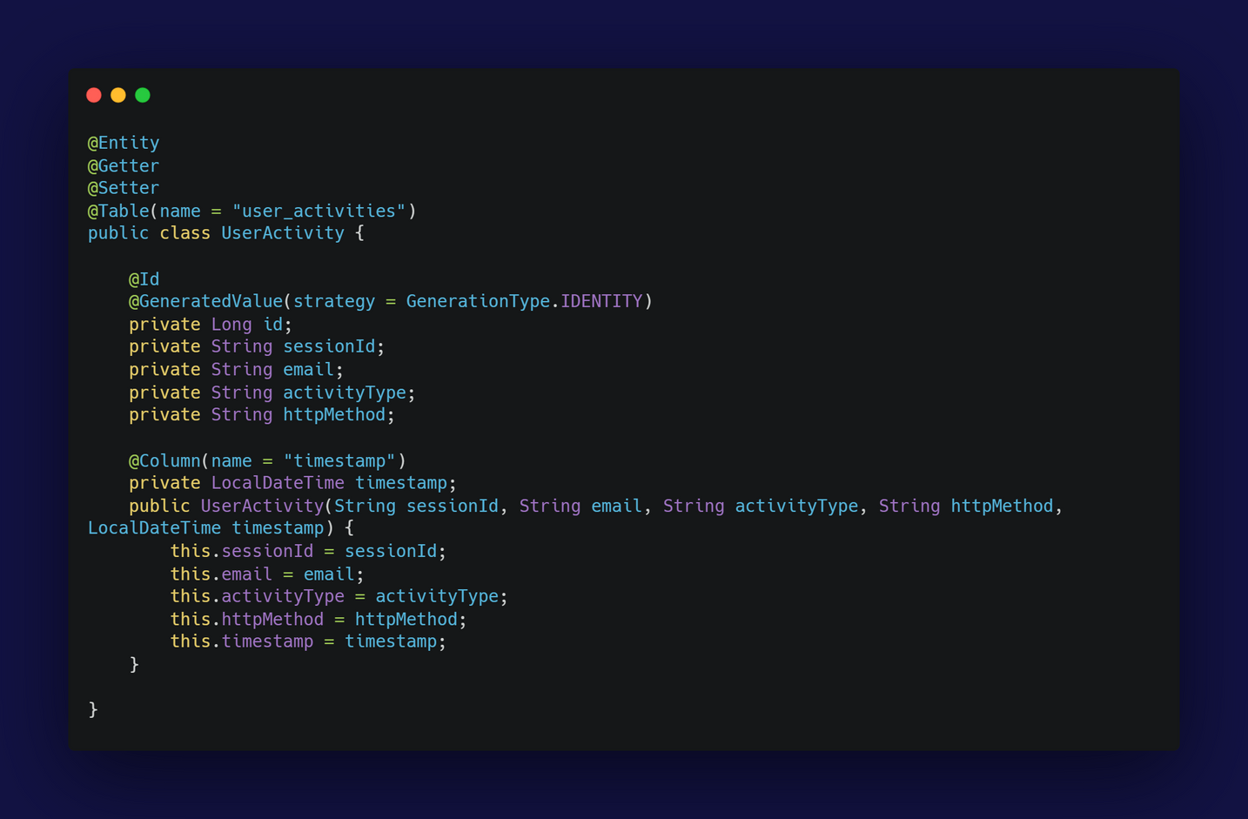
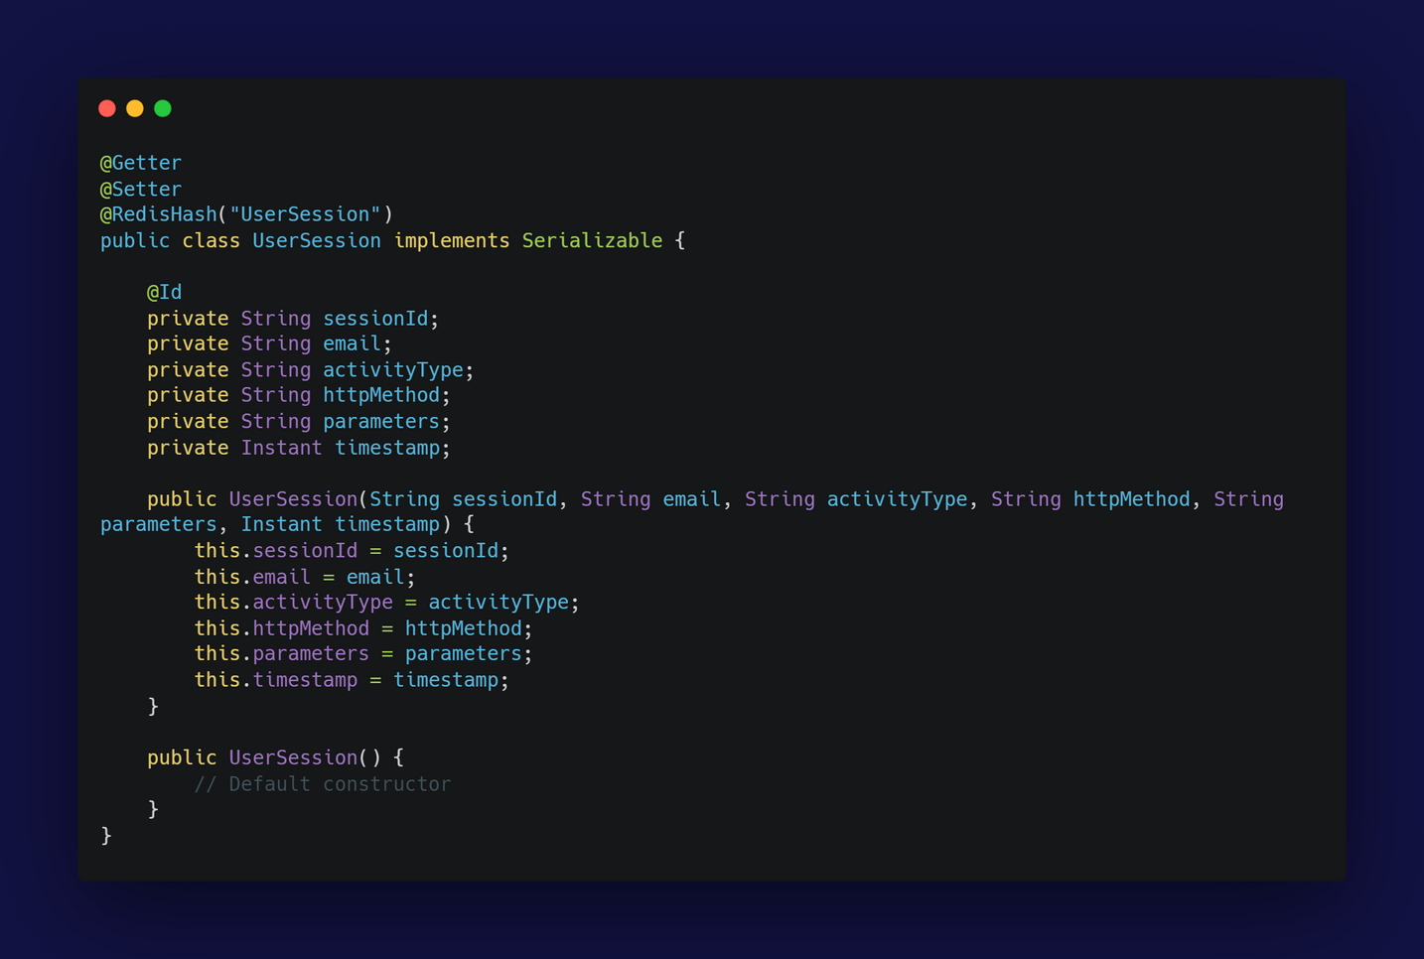
The User Session class models It uses @Redishash for persistence in the memory as key and value, where each session being stored as a hash in the Redis database with the activity with TTL(Time To Live) : 30 mins
The UserActivity class is a JPA entity that maps to the "user_activities" table in a relational database. It stores information about user activities, This entity can be used to log and audit user actions within an application, providing valuable data for monitoring and analysis
caching session
In Memory
SAVE USER ACTIVITY IN NORMAL DATABASE

Slide 52
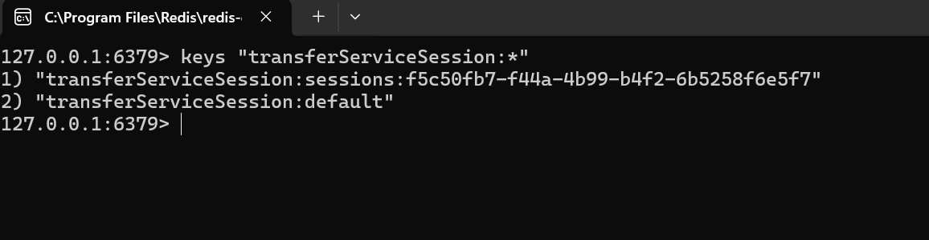
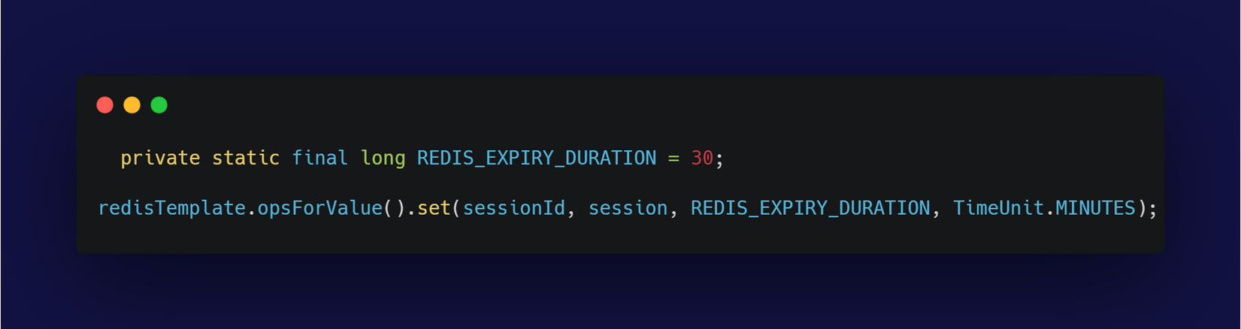
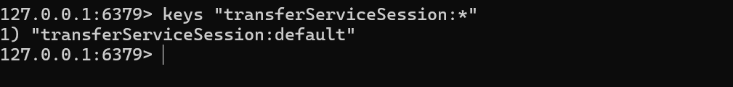
THIS AT THE BEGAINNING OF THE SESSION CREATION SAVED IN REDIS AND IT STORED IN THE CACHE MEMORY
THIS AFTER 30 MINS THE SESSION TERMINATED FROM CACHE MEMORY DUE TO INACTIVITY

Slide 53
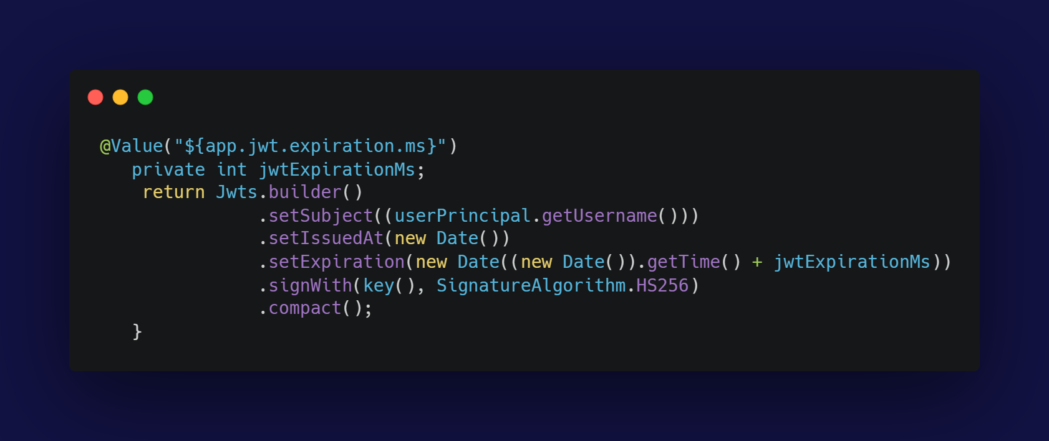
handle the token expire date to be 30 minutes that is saved in the properties file

Slide 54
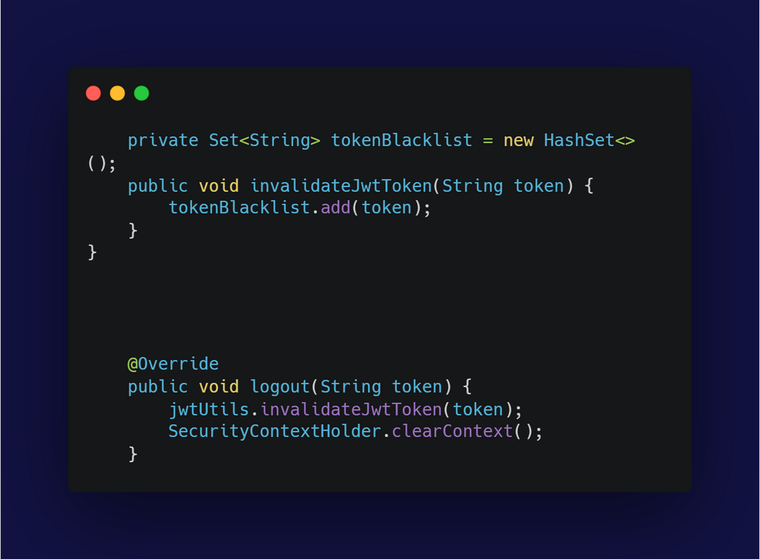
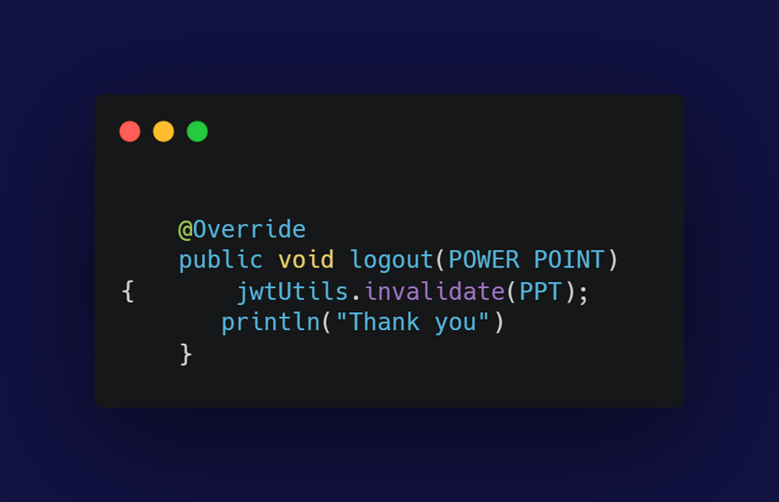
LOG OUT USING THE BLACK LIST SET TO INVALIIDATE THE TOKEN
thank
you

